Slide 1
AWS Lambda
December 2019

Slide 2
AWS Lambda
Introduction
Lambda Runtimes
Triggering Mechanism
Lambda Execution Role
Adding Triggers to AWS Lambda
Code entry types
Lambda Layers
Lambda Environment Variables
Lambda Basic Settings
Lambda use case

Slide 3
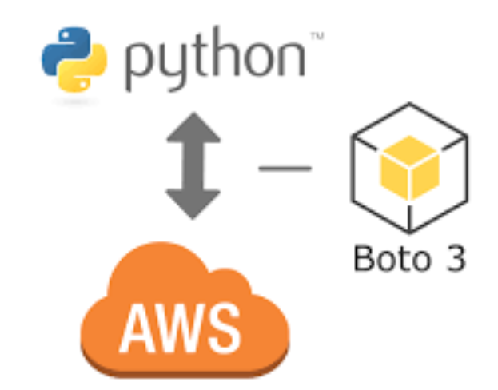
Introduction
AWS Lambda lets you run code without provisioning or managing servers. You pay only for the compute time you consume.
With Lambda, you can run code for virtually any type of application or backend service - all with zero administration. This is called “Serverless” model.
Just upload your code and Lambda takes care of everything required to run and scale your code with high availability.
You can set up your code to automatically trigger from other AWS services or call it directly from any web or mobile app.
A Typical AWS Lambda Code can be written in Python.
Resource provisioning is handled by AWS automatically to execute the code.
Boto3 SDK is provided for accessing AWS Services from Python Code, which can be executed in AWS Lambda platform as shown in the given diagram.

Slide 4
Introduction – Contd.
AWS Lambda manages all the administration:
Server and OS maintenance
Provisioning and capacity planning of compute fleet that offers a balance of memory, CPU, network and other resources
High availability and automated scaling
Monitoring fleet health
Applying security patches
Deploying your code
Monitoring and logging your lambda functions

Slide 5
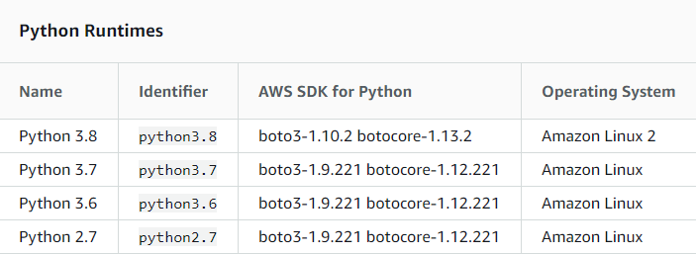
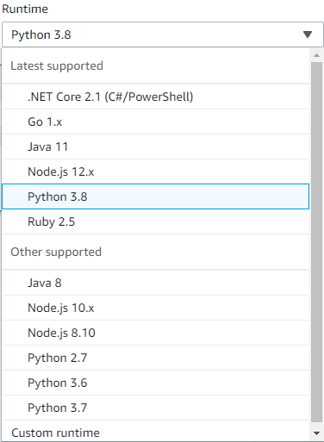
Lambda Runtimes
AWS Lambda supports multiple languages through the use of runtimes. You choose a runtime when you create a function, and you can change runtimes by updating your function's configuration. The underlying execution environment provides additional libraries and environment variables that you can access from your function code.
List of Runtimes
Note: Apart from Python there are other runtimes supported in AWS Lambda like Node.js , Ruby, Java, Go, .NET Core etc. Use the below link for more details.
https://docs.aws.amazon.com/lambda/latest/dg/lambda-runtimes.html

Slide 6
Triggering Mechanism
There are three categories by which you can use Other Services along with AWS Lambda.
Services That Lambda Reads Events From
Amazon Kinesis
Amazon DynamoDB
Amazon Simple Queue Service
Services That Invoke Lambda Functions Synchronously
Amazon Alexa
Amazon API Gateway and many more.
Services That Invoke Lambda Functions Asynchronously
Amazon Simple Storage Service
Amazon Simple Notification Service
Amazon CloudWatch Logs
Amazon CloudWatch Events and many more.
Note: Use the below link for more details.
https://docs.aws.amazon.com/lambda/latest/dg/lambda-services.html

Slide 7
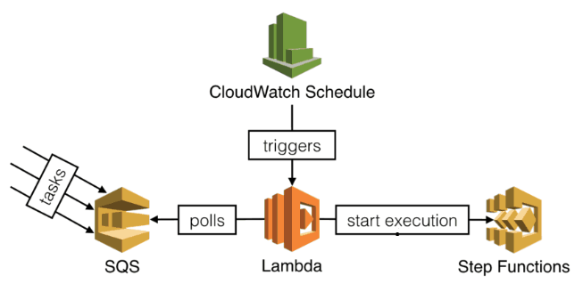
Triggering Mechanism – Contd.
Reading Events from SQS
Note: Use the below link for more details.
https://docs.aws.amazon.com/lambda/latest/dg/lambda-services.html

Slide 8
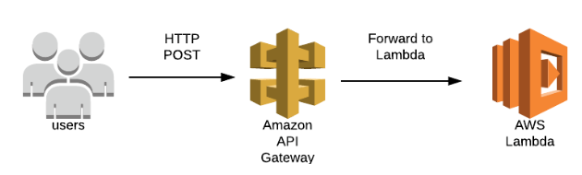
Triggering Mechanism – Contd.
Synchronous Invocation using API Gateway
Note: Use the below link for more details.
https://docs.aws.amazon.com/lambda/latest/dg/lambda-services.html

Slide 9
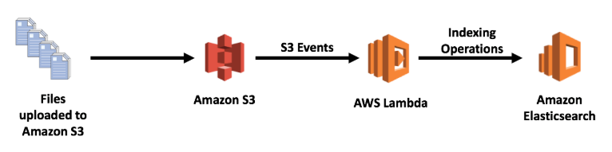
Triggering Mechanism – Contd.
Asynchronous Invocation using S3 Event
Note: Use the below link for more details.
https://docs.aws.amazon.com/lambda/latest/dg/lambda-services.html

Slide 10
Lambda Execution Role
An AWS Lambda function's execution role grants it permission to access AWS services and resources. You provide this role when you create a function, and Lambda assumes the role when your function is invoked. You can create an execution role for development that has permission to send logs to Amazon CloudWatch, and upload trace data to AWS X-Ray.
To create an execution role
Open the Roles page in the IAM console.
Choose Create role.
Create a role with the following properties:
Trusted entity – AWS Lambda
Permissions – AWSLambdaBasicExecutionRole
Role name – lambda-role
You can add or remove permissions from a function's execution role at any time, or configure your function to use a different role. Add permissions for any services that your function calls with the AWS SDK, and for services that Lambda uses to enable optional features.
Managed policies provide permissions that are required to use Lambda features:
AWSLambdaBasicExecutionRole – Permission to upload logs to CloudWatch.
* On top of this, IAM Policies can be added as per requirement of the use cases.
Note: Use the below link for more details.
https://docs.aws.amazon.com/lambda/latest/dg/lambda-intro-execution-role.html

Slide 11
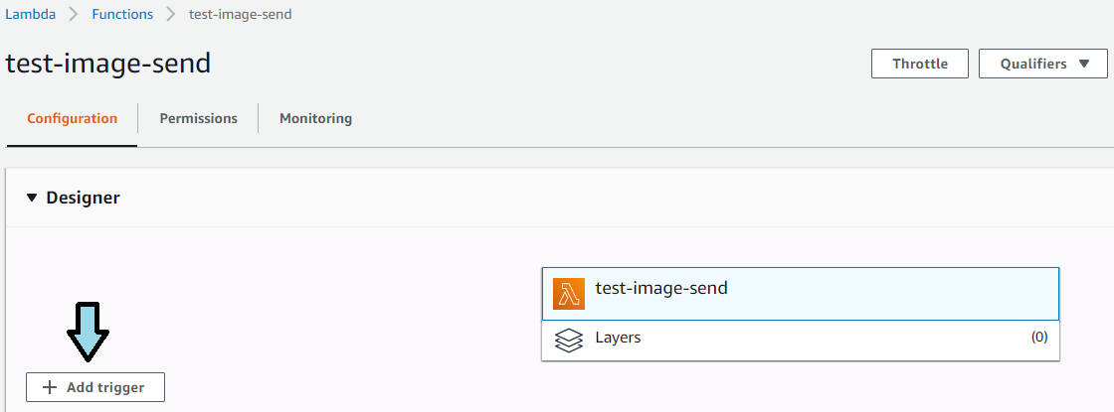
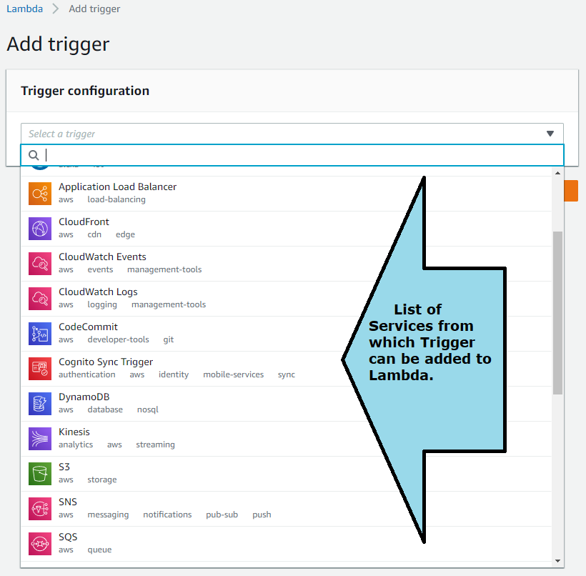
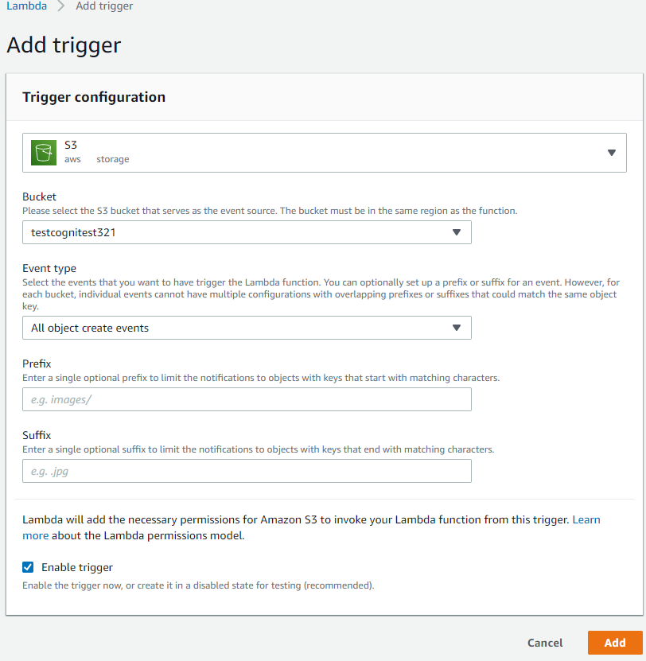
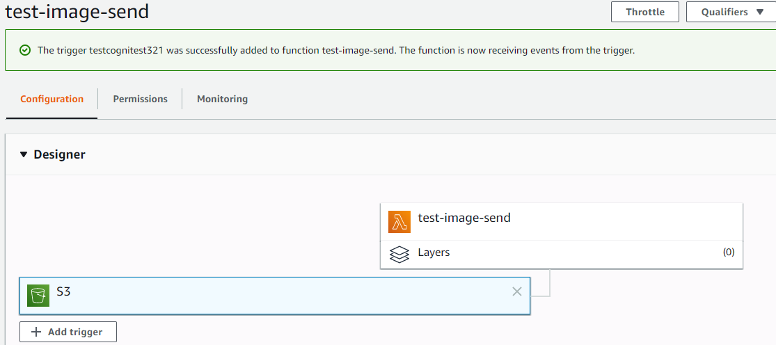
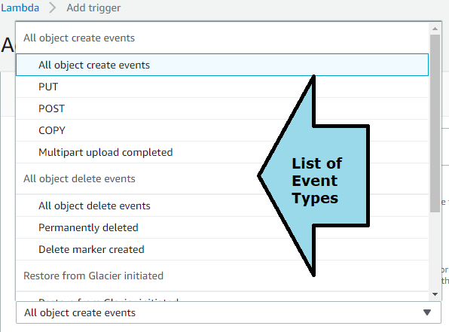
Adding Triggers to AWS Lambda
We can add Trigger from the List of Services supported in the Designer Pane. By adding this Lambda can be invoked by other services. Below is an example of adding S3 as event trigger for Lambda.

Slide 12
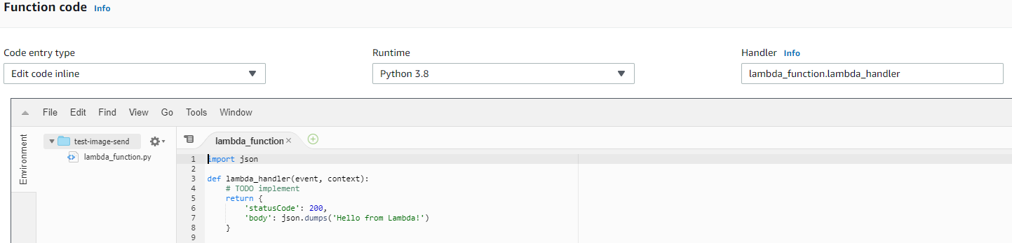
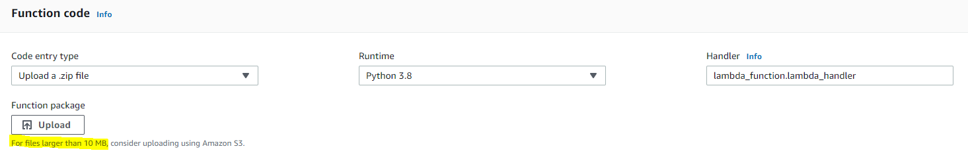
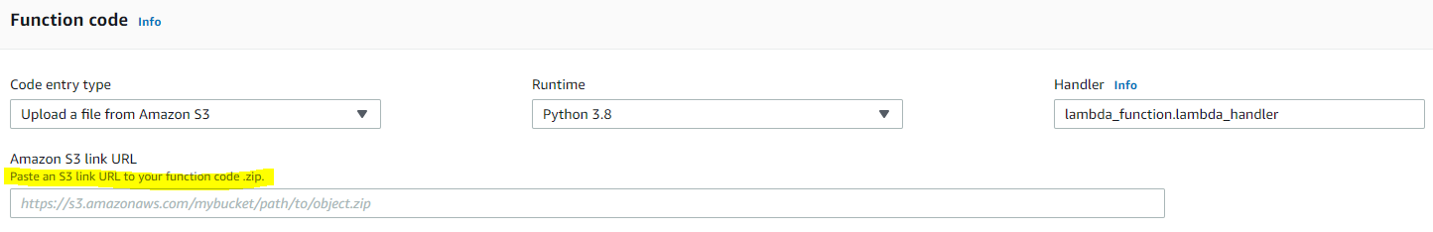
Code entry types
We can choose different code entry types for development.
Edit code inline – Codes that can be put in editor directly
Upload a .zip file – Codes with external packages as dependencies
Upload a file from Amazon S3 – Codes with external packages as dependencies (For files larger than 10 MB)

Slide 13
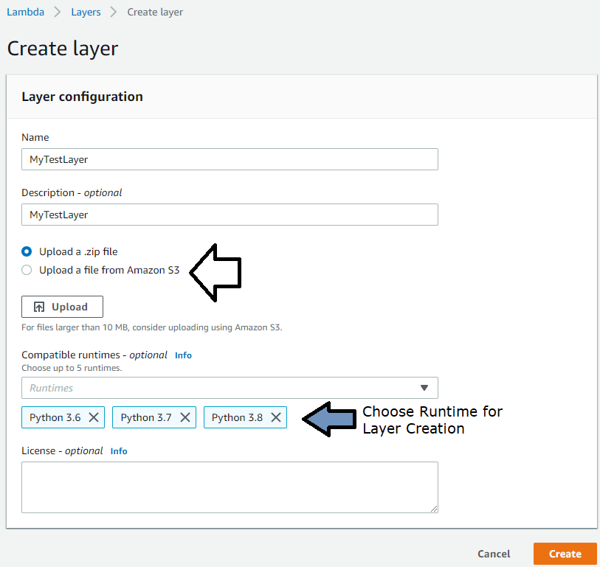
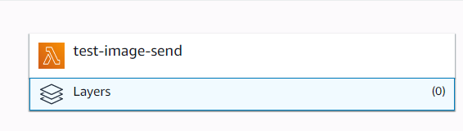
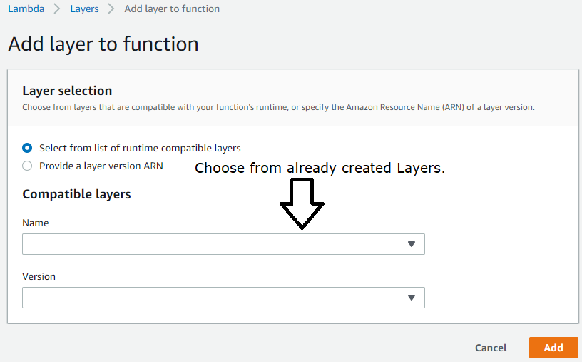
Lambda Layers
You can configure your Lambda function to pull in additional code and content in the form of layers. A layer is a ZIP archive that contains libraries, a custom runtime, or other dependencies. With layers, you can use libraries in your function without needing to include them in your deployment package.
Layers let you keep your deployment package small, which makes development easier. You can avoid errors that can occur when you install and package dependencies with your function code. For Node.js, Python, and Ruby functions, you can develop your function code in the Lambda console as long as you keep your deployment package under 3 MB.
Note: A function can use up to 5 layers at a time. The total unzipped size of the function and all layers can't exceed the unzipped deployment package size limit of 250 MB. Use the provided link for more details. https://docs.aws.amazon.com/lambda/latest/dg/configuration-layers.html

Slide 14
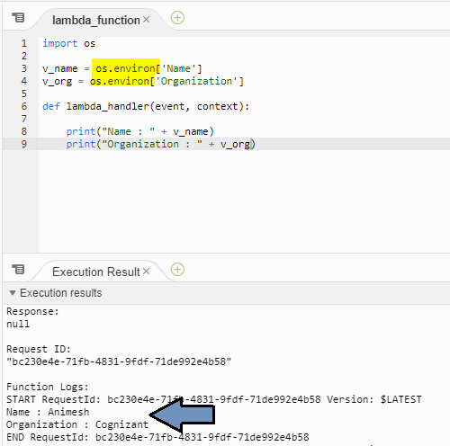
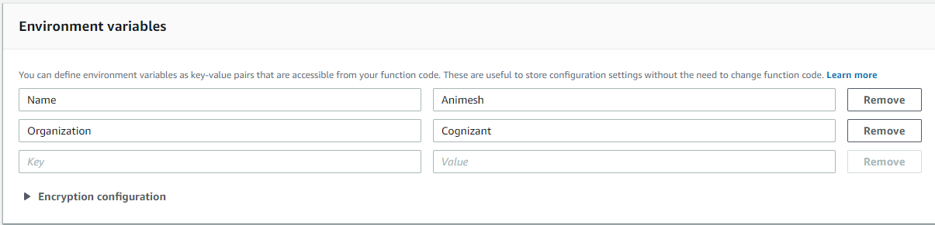
Lambda Environment Variables
Environment variables for Lambda functions enable you to dynamically pass settings to your function code and libraries, without making changes to your code. Environment variables are key-value pairs that you create and modify as part of your function configuration, using either the AWS Lambda Console, the AWS Lambda CLI or the AWS Lambda SDK.
You can use environment variables to help libraries know what directory to install files in, where to store outputs, store connection and logging settings, and more. By separating these settings from the application logic, you don't need to update your function code when you need to change the function behavior based on different settings.
Using environment variable to pass value to Lambda function. Access the same Variable using OS Module
Use the provided link for more details. https://docs.aws.amazon.com/lambda/latest/dg/env_variables.html

Slide 15
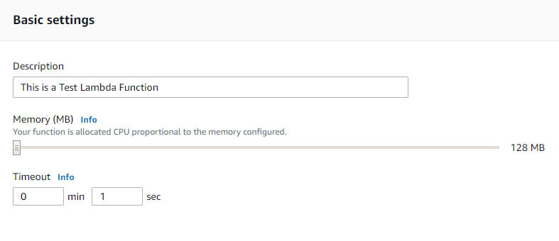
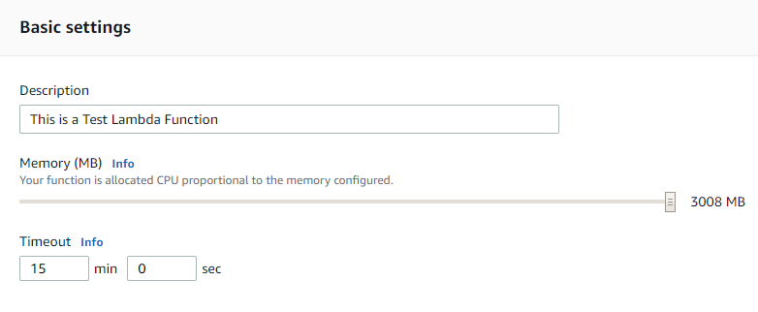
Lambda Basic Settings
Basic Settings section allows to put description , handle timeout and required memory for the Lambda function.
Lambda function with minimum timeout and memory
Lambda function with maximum timeout and memory

Slide 16

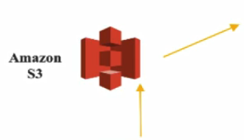
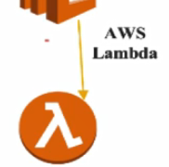

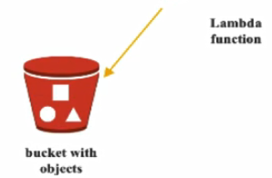


Lambda use case
You have a photo sharing application. People use your application to upload photos and these photos gets stored in S3 buckets.
Then your application creates a thumbnail version of each user’s photos and displays them on the user’s profile page. A lambda function is used which will create the thumbnail automatically.
Amazon S3 is one of the supported AWS event source that can publish object-created events and invoke your Lambda functions.

Slide 17
References
AWS : https://aws.amazon.com/lambda/
AWS Docs : https://docs.aws.amazon.com/lambda/index.html

